Slide 1
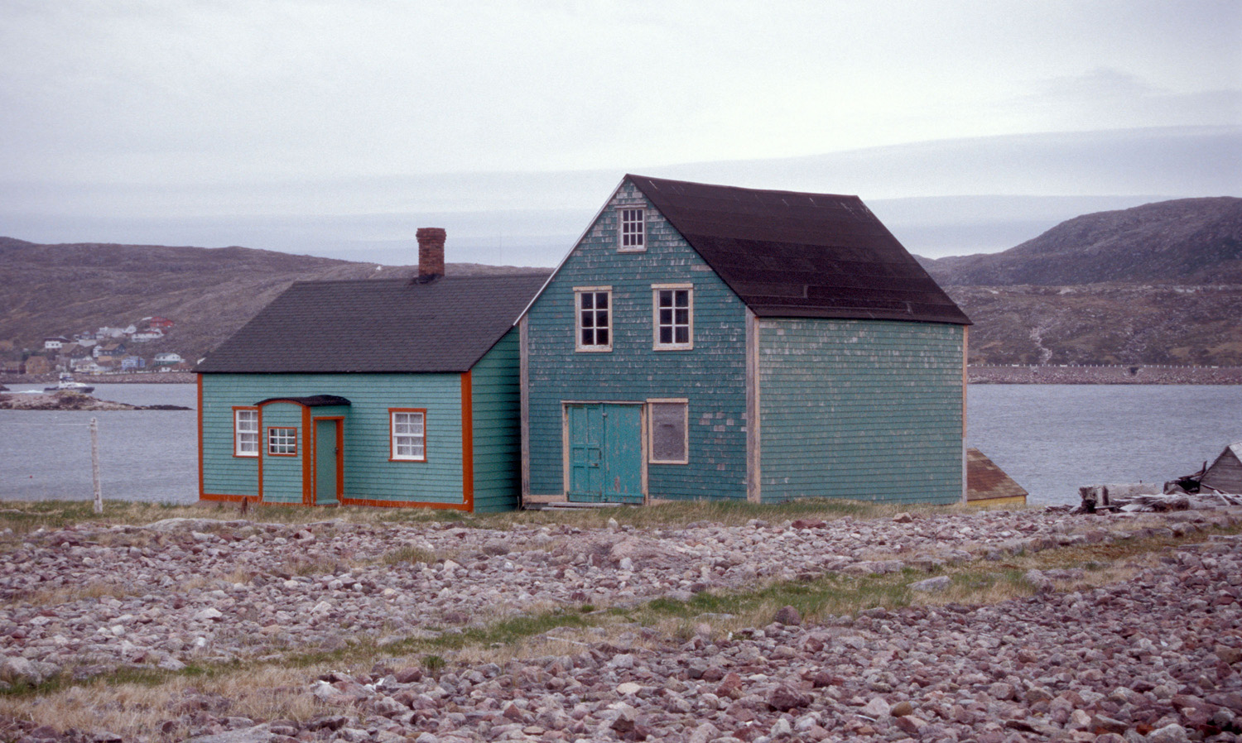
Vernacular Architecture
Part of The Vernacular Architecture Forum’s Tools for Education Initiative
Maison Morel, 1916, and Saline Morel, late 19thc.,
Ile-aux-Marins, St. Pierre et Michelon, France (Off the coast of north-eastern Canada). Photo by Carl R. Lounsbury2003.
Notes:
VERNACULAR ARCHITECTURE
________________________________________________
What is Vernacular Architecture?
Architecture, as a concept, we probably all understand.
But what is “vernacular”?
Maybe you have heard the word used with respect to language to mean colloquial, common speech, or ways of saying things, often in a certain part of the world or a particular culture.
So Vernacular means everyday, common, ordinary, and often local to a particular place. Then what does vernacular mean when paired with the word architecture?
Even though we all understand that architecture is buildings, we also probably think of it as architecture with a Big ”A” – designed by a famous architect like Frank Lloyd Wright or Frank Gehry.
But architecture can also be used with a little “a” to encapsulate any alteration of the landscape made for human use. That means that architecture as a whole can be a huge category. Vernacular Architecture, then, refers to a focus within the study of architecture that includes the everyday, common spaces, and buildings that we all make and inhabit.
_______________________________________________________
CREDITS
This slideshow and notes are adapted from Thomas Carter and Elizabeth Collins Cromley, Invitation to Vernacular Architecture: A Guide to the Study of Ordinary Buildings and Landscapes. Vernacular Architecture Series, Diane Shaw, ed. Knoxville: University of Tennessee Press, 2005.
Created by Sarah Fayen Scarlett, VAF Education Committee, 2014.
If you alter the slides, please be sure to include the photography credits as featured on the slides. Thank you.
Further Photo Copyright information below:
Photos by Carl R. Lounsbury © Carl R. Lounsbury, Colonial Williamsburg Foundation
Photos by Susan Kern © Susan A. Kern
Photos by Jeff Klee © Jeffrey E. Klee, Colonial Williamsburg Foundation
Photo by Alex Cross © Alex Cross
Photo by Kevin Enns-Remple © Kevin Enns-Remple
Photos by Arnold R. Alanen © Arnold R. Alanen
Photo by Dee Finnegan © Dee Finnegan
Drawing by Thomas Carter, James Gosney, and Travis Olson appear in Anna Vemer Andrzejewski, Arnold R. Alanen, and Sarah Fayen Scarlett, co-editors, From Mining to Farm Fields to Ethnic Communities: Buildings and Landscapes of Southwestern Wisconsin: A Field Guide to the Vernacular Architecture Forum Annual Conference, 7 June 2012 (Madison, Wisc.: Department of Art History and Department of Landscape Architecture, 2012), 322, 333. Available as a pdf at http://www.blc.wisc.edu.
G. Wright “Maps of Milwaukee” was accessed from the American Geographical Society Library Digital Map Collection, University of Wisconsin—Milwaukee. Available at http://collections.lib.uwm.edu/u?/agdm,684. Accessed April 2010.

Slide 2
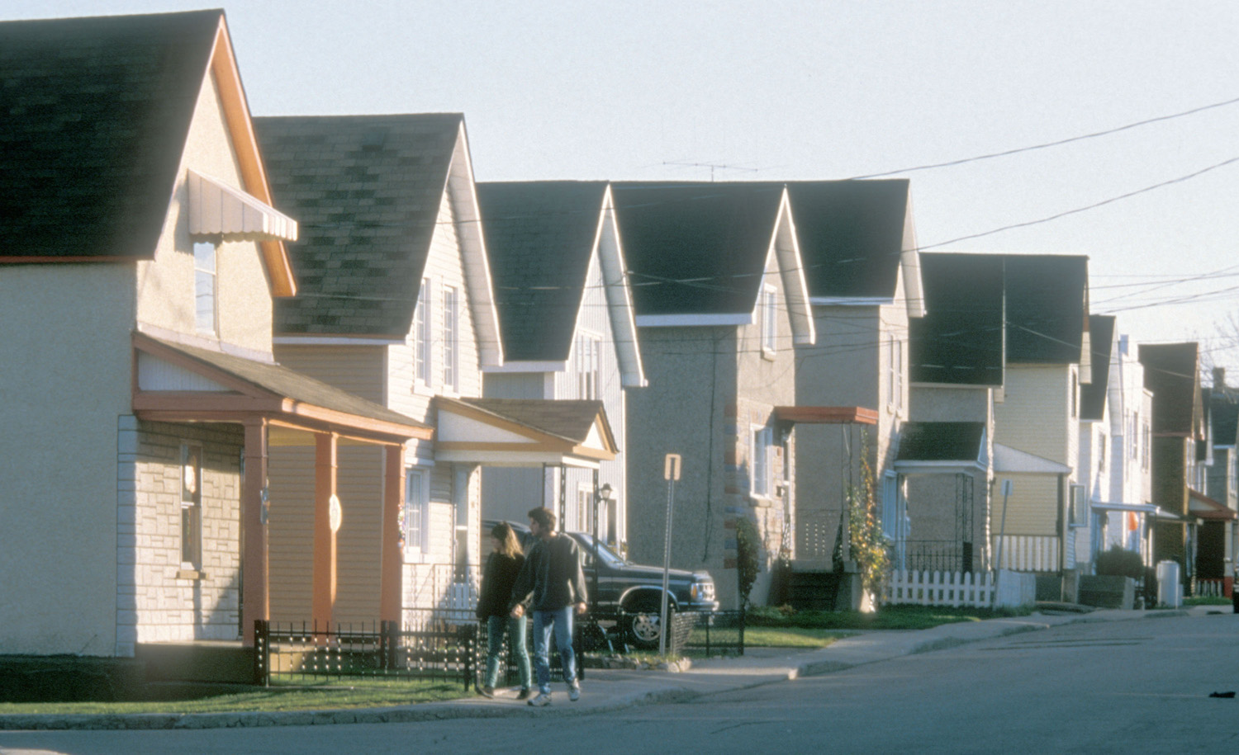
“Vernacular architecture is the study of those human actions and behaviors that are manifest in commonplace architecture.”
– Thomas Carter and Elizabeth Collins Cromley, 2005
50–56 Rue St. Hyacinthe, early 20thc. Hull, Québec, Canada. Photo by Alex Cross
1995.
Notes:
A concise definition comes from Tom Carter and Elizabeth Cromley (2005):
“Vernacular Architecture is the study of those human actions and behaviors that are manifest in commonplace architecture.” *
Let’s expand that sentence a little.
“Actions?” – What do the authors mean?
Actions can include many things that we do to shape our surroundings, including the actual construction of a building, alterations to a building over time, the way multiple buildings are arranged with relation to one another, the alterations made to the landscape to accommodate human building or activities. The actions, in other words, include a lot more than construction.
* Thomas Carter and Elizabeth Collins Cromley, Invitation to Vernacular Architecture: A Guide to the Study of Ordinary Buildings and Landscapes. Vernacular Architecture Series, Diane Shaw, ed. (Knoxville: University of Tennessee Press, 2005), xiv.

Slide 3
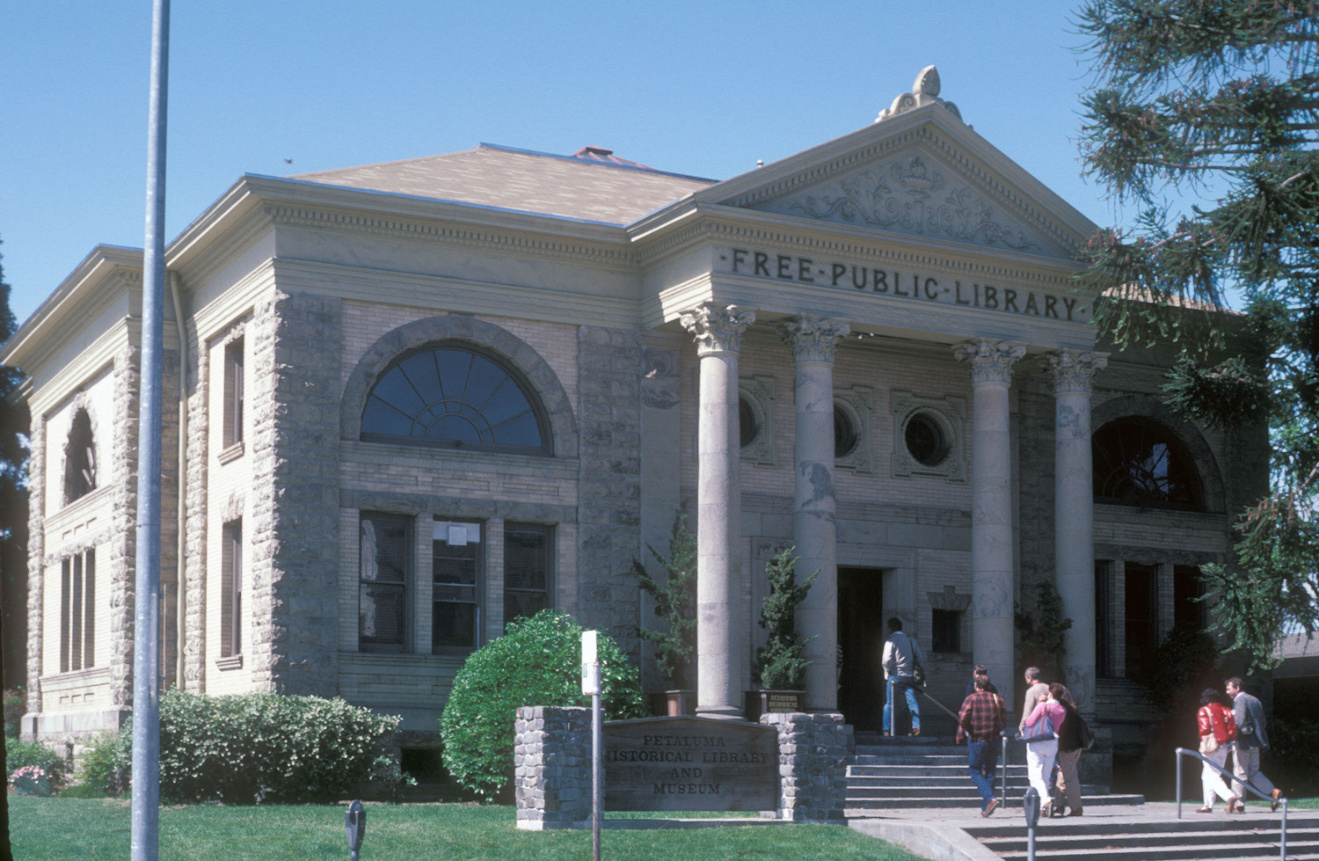
“Vernacular architecture is the study of those human actions and behaviors that are manifest in commonplace architecture.”
– Thomas Carter and Elizabeth Collins Cromley, 2005
Carnegie Library, 1904. Petaluma, California. Photo by Carl R. Lounsbury
1985.
Notes:
“Behaviors?”
This word reminds us that vernacular architecture is not just the study of the creation of these buildings and landscapes, but also how we live within these buildings and landscapes over time. The spaces we use everyday influence how we act, how we interact with others, and how we continue to alter our landscapes.
“Commonplace?”
Commonplace is a perfect word to describe Vernacular Architecture studies. “Common” suggests familiar and also shared, which conjures up the human relationships and interactions that are the ultimate interest of humanities scholars. And “place” reminds us that while a lot of vernacular architecture takes cues from widespread popular fashions, it also is always tied to a particular place. Buildings and landscapes sit on the earth’s surface at particular coordinates. And the particular situation of that place – ecological, social, cultural, and geographical – also influences vernacular architecture.

Slide 4
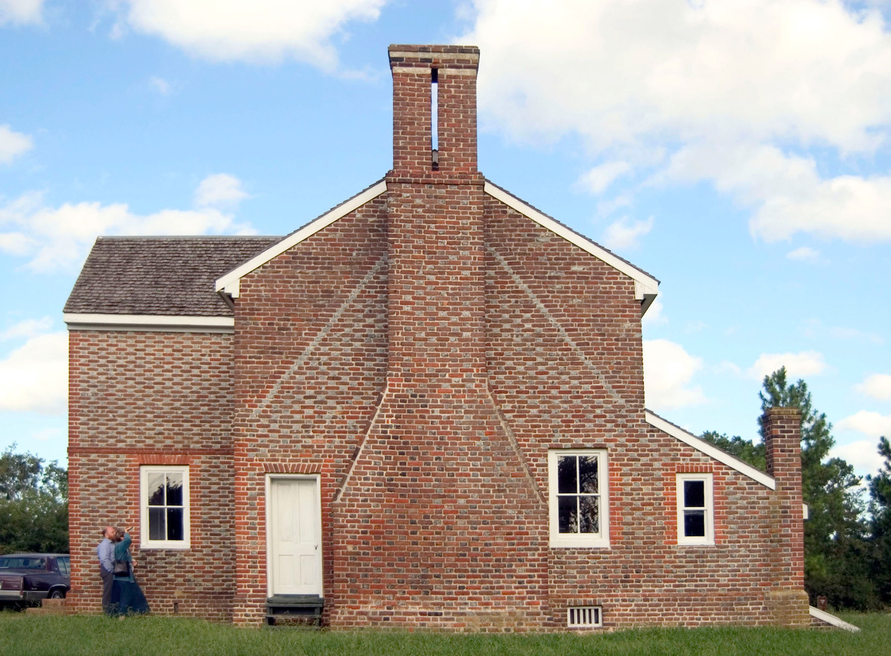
Individual buildings
Matthew Jones House,
c. 1720, 1727, 1729, 1892-93. Newport News, Virginia. Photo by Carl R. Lounsbury2004.
Notes:
So what does this definition of Vernacular Architecture actually look like? It is extremely varied.
On a basic level, vernacular architecture can be individual buildings, like this early eighteenth-century brick house in Virginia…

Slide 5
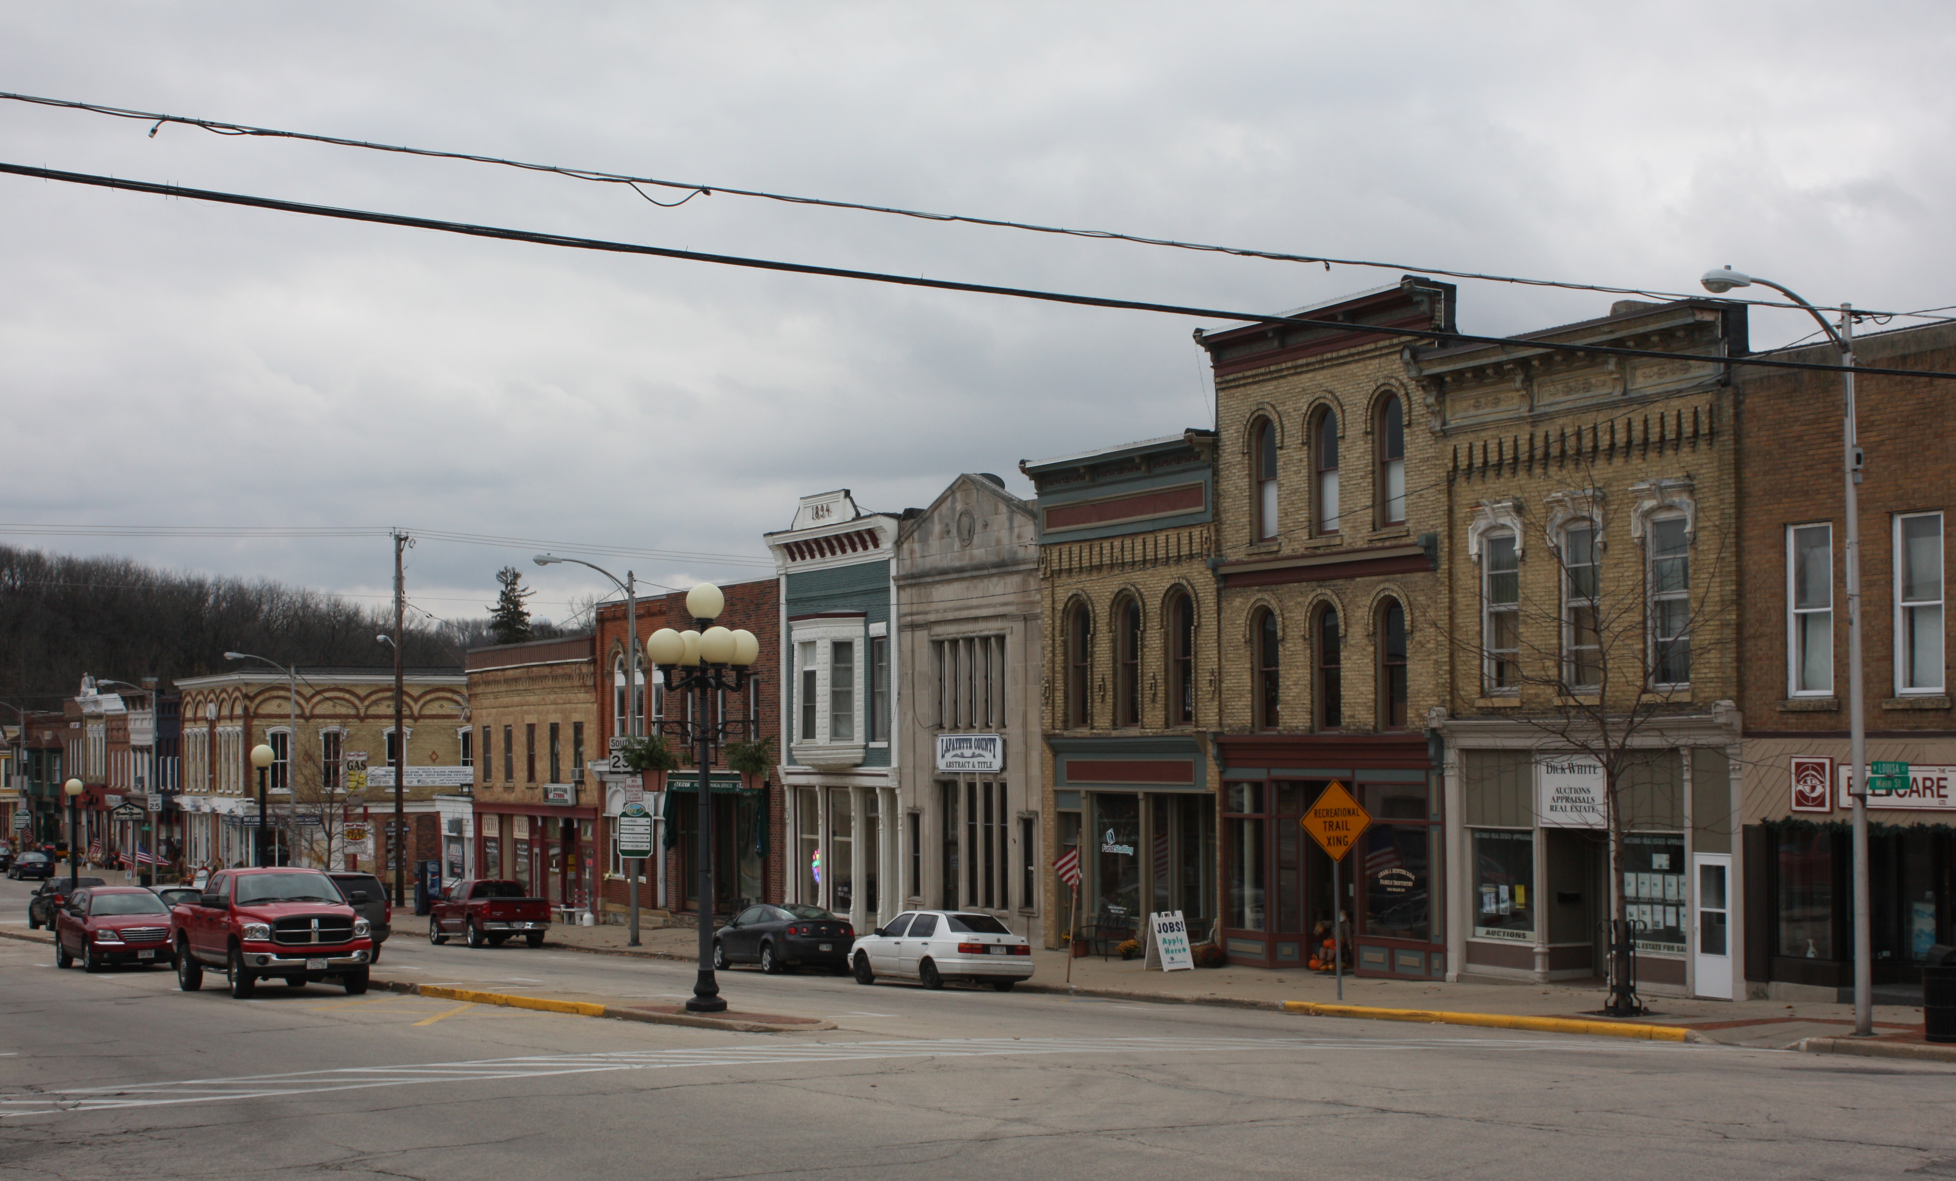
Assemblages of buildings
Main St., Darlington, Wisconsin Photo by Arnold R. Alanen. 2010.
Notes:
…assemblages of buildings, like this main street commercial district…

Slide 6
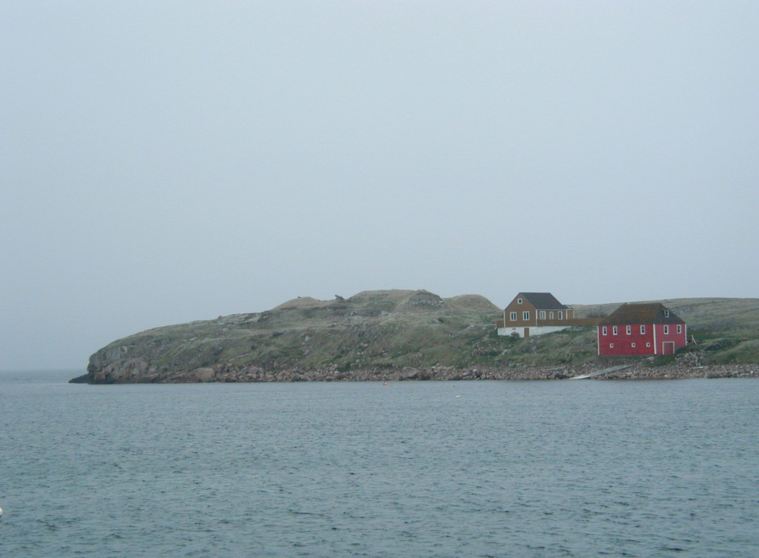
Landscapes
St. Pierre et Michelon, France (Off the coast of north-eastern Canada). Photo by Jeff Klee.
2003.
Notes:
…or entire landscapes, like this fishing community off the coast of northeastern Canada.

Slide 7
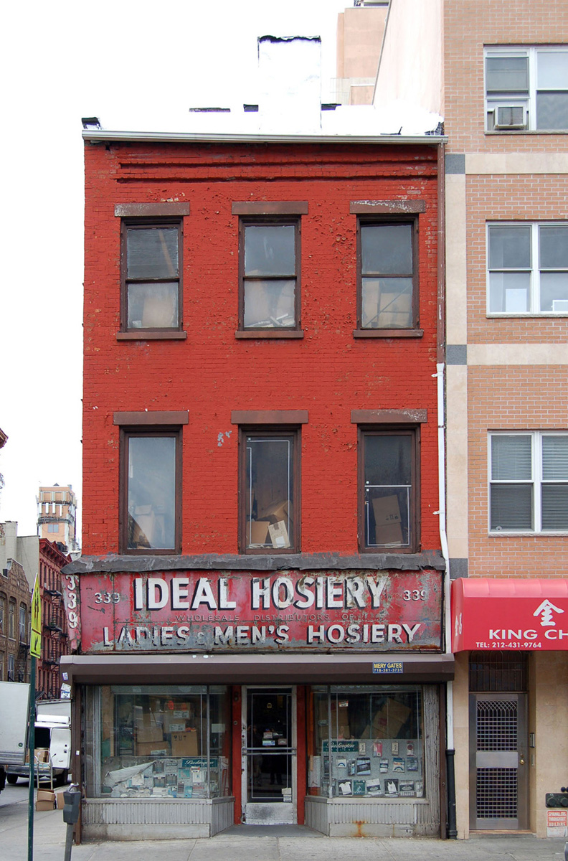
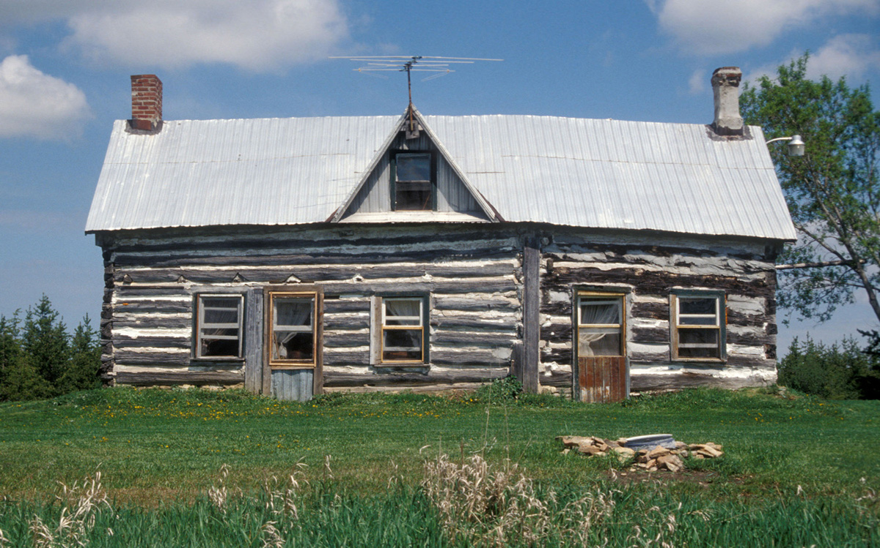
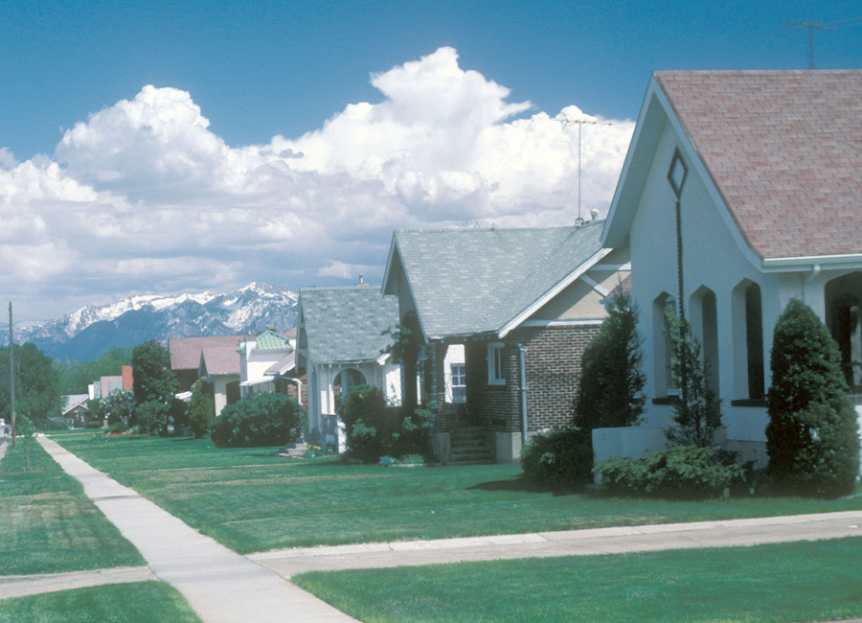
Any kind of place: rural, urban, or suburban
339 Grand St, 1820s, Lower East Side, New York City. Photo 2006.
Gilroy Farm-house, 1850s. Rideau Township, Ottowa, Canada. Photo 1995.
Copperton, Utah, 20th-century. Photo 1987.
All photos by Carl R. Lounsbury
Notes:
And those individual buildings, assemblages, and landscapes can themselves differ dramatically.
Vernacular Architecture can be in any kind of place: rural, urban, or suburban…

Slide 8
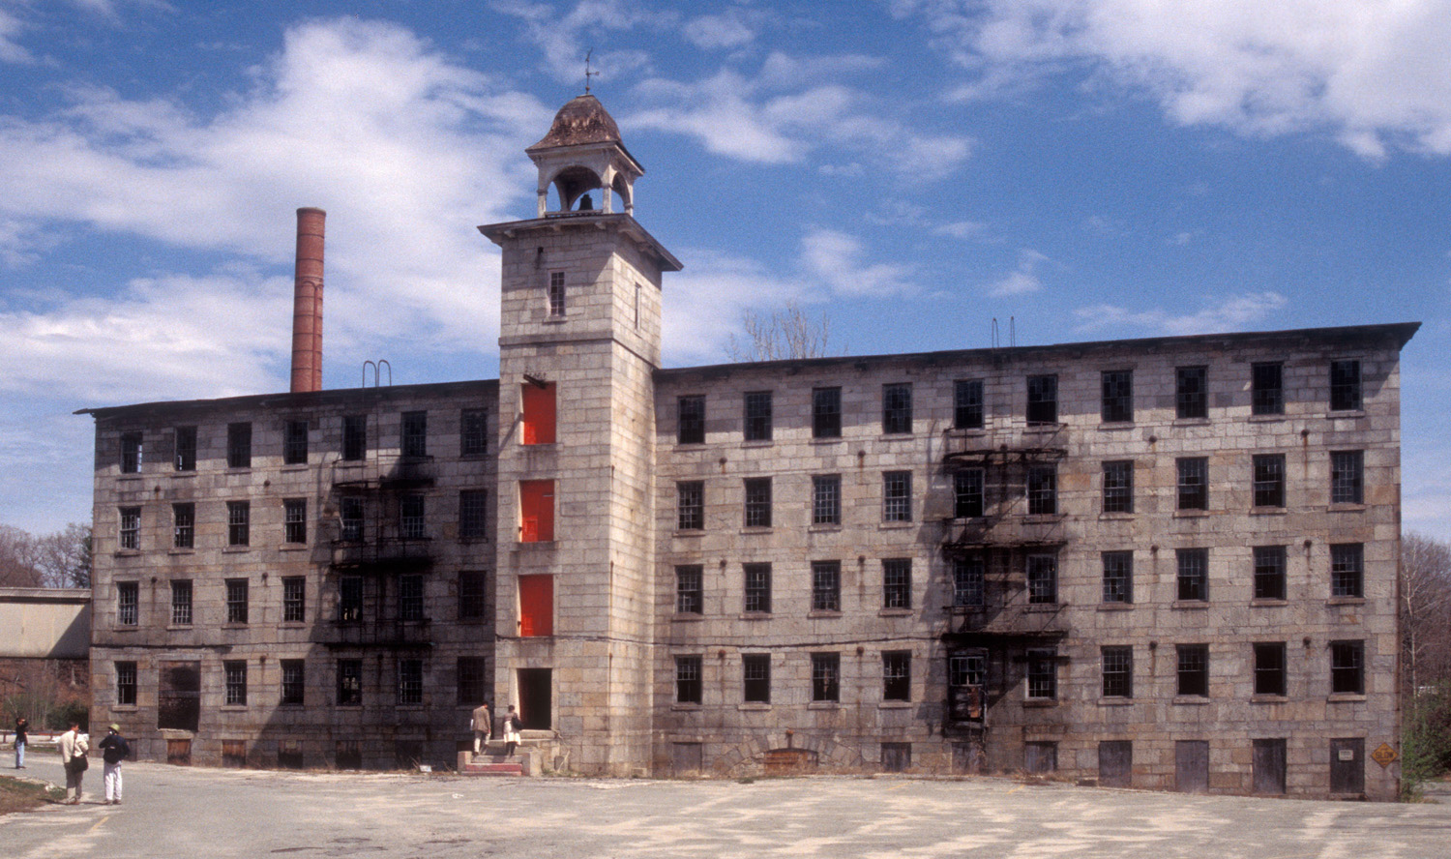
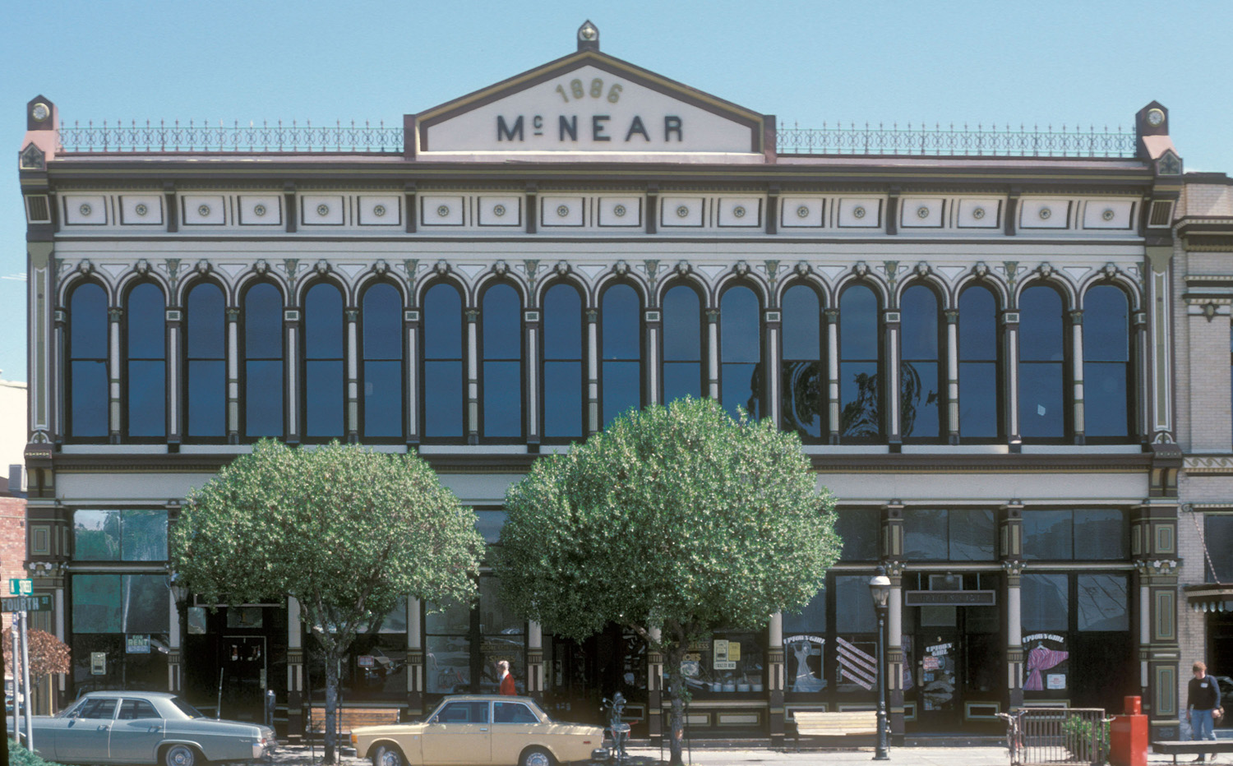
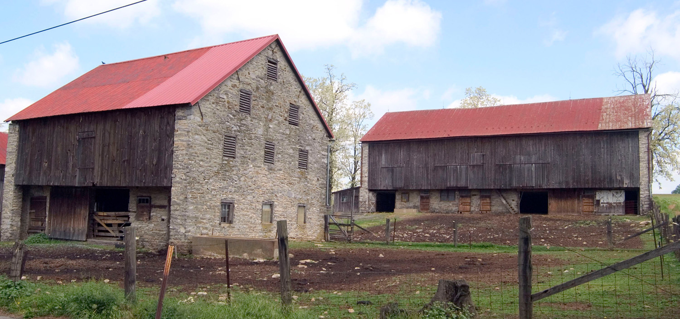
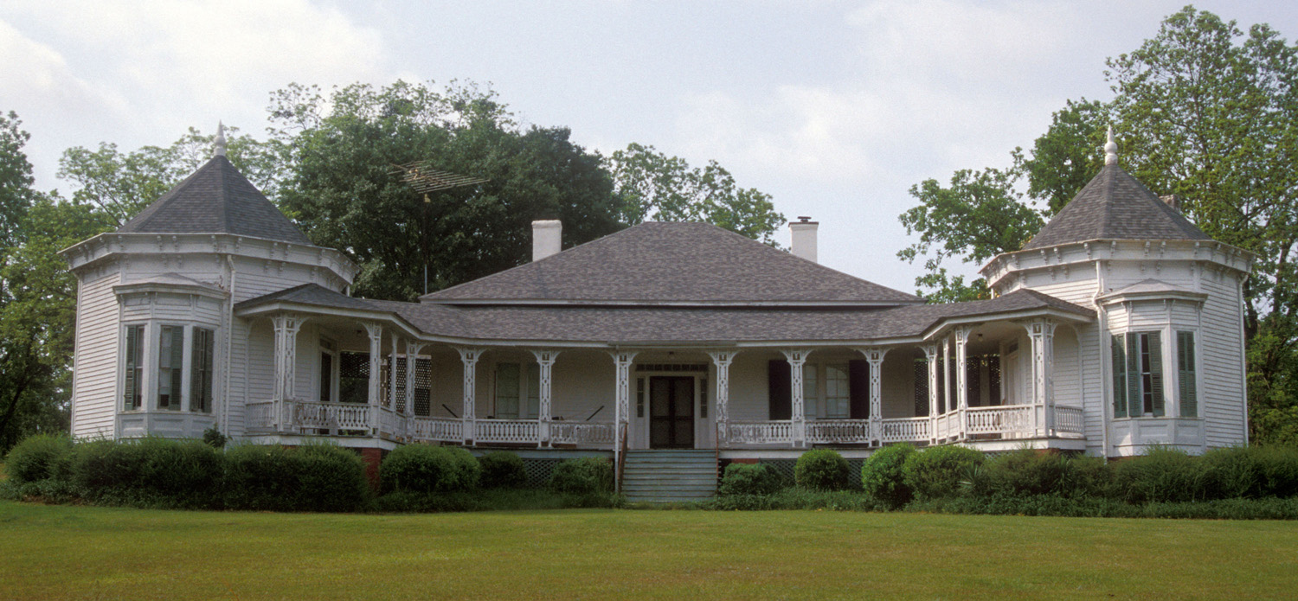
Any kind of use: agricultural, commercial, domestic, or industrial
Center Mill, 1806–07, Slaters-ville, Rhode Island. Photo 2001.
McNear Building, 1886. Petaluma, California. Photo 1985.
Kauffman Barns, Berks Cty, Pennsyl-vania. Photo 2004.
Parker House,
c. 1840. Talbot Cty, Georgia. Photo 1999.
All photos by Carl R. Lounsbury
Notes:
…Vernacular Architecture can made for any kind of use: agricultural, commercial, domestic, and industrial…

Slide 9
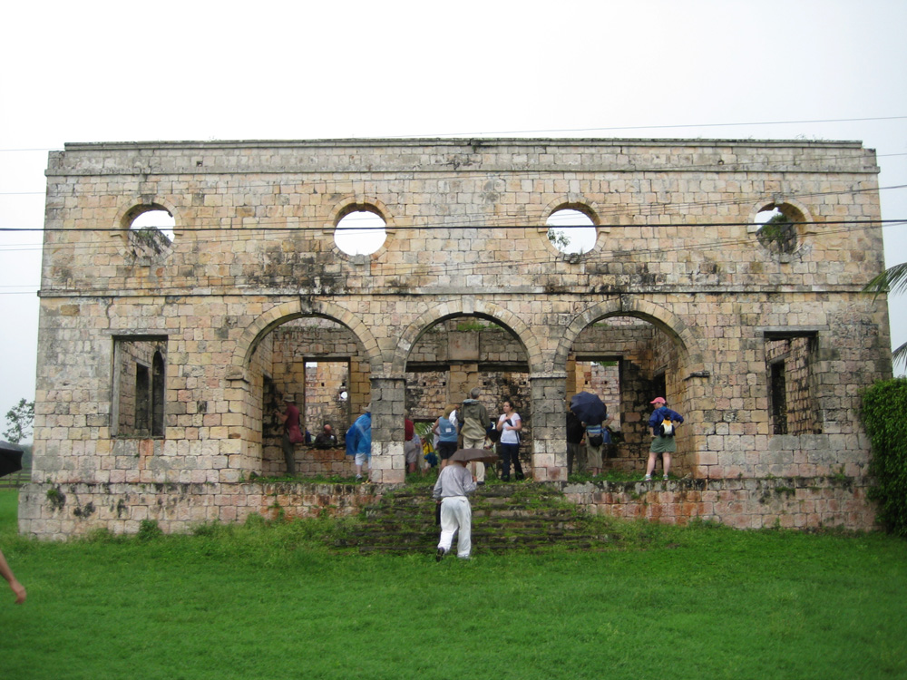
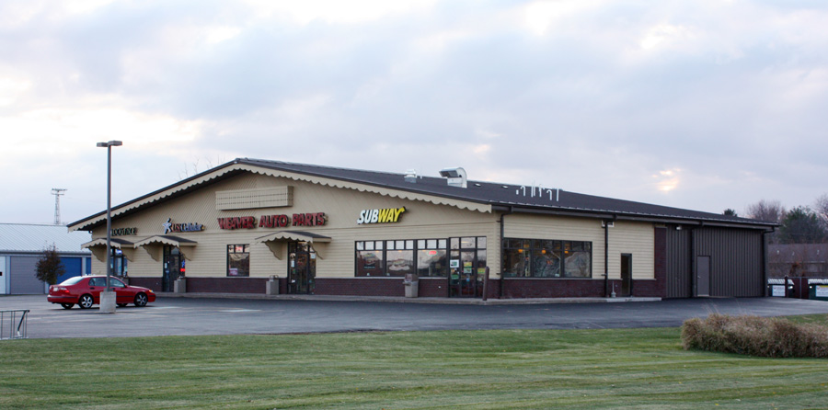
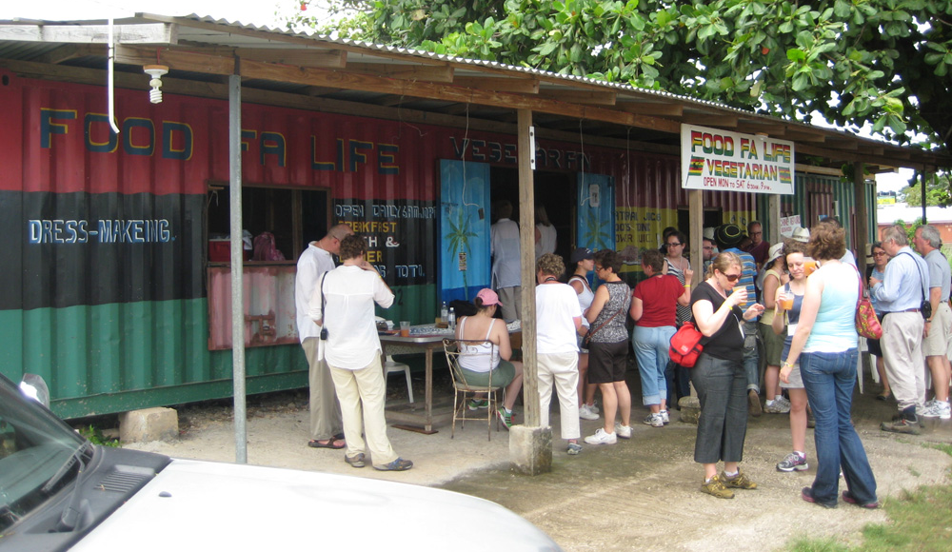
Orange Valley Slave Hospital, Trelawny Parish, Jamaica. Photo by Sarah Fayen Scarlett. 2011.
“Swiss-ified” bldg, New Glarus, WisconsinPhoto by Arnold R. Alanen. 2011.
Food Fa Life restaurantTrelawny Parish, Jamaica. Photo by Sarah Fayen Scarlett, 2011.
Any age: very old and very new
And also re-used and
re-imagined over time
Notes:
…Vernacular Architecture can be very old, or quite new…
… and also reused and reimagined over time, such as this metal shipping container repurposed as a road-side jerk restaurant in northern Jamaica.
Any of these examples can serve as primary evidence for Vernacular Architecture research. Our observations and analysis come from first-hand detailed and thoughtful focus on the buildings and landscapes themselves. In this way, Vernacular Architecture studies are “object-driven.” Our primary questions derive from the physical evidence or the “object” itself.

Slide 10
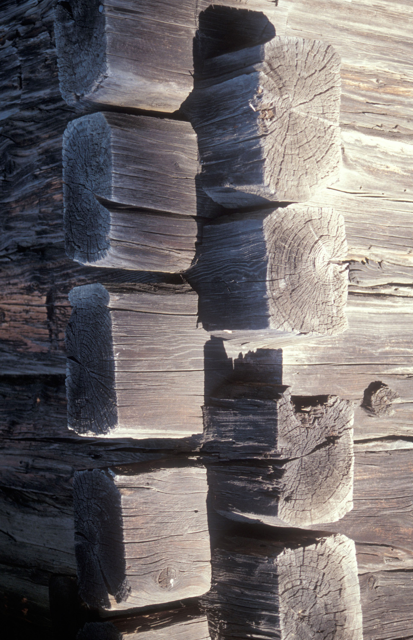
Material Culture is “that segment of [the human] physical environment which is purposely shaped... according to culturally dictated plans.”
– James Deetz
Notching on barn, Hanka Farm, after 1910. St. Louis Cty, MinnesotaPhoto by Carl R. Lounsbury2000.
Notes:
For instance, the notching technique used in this log building in northern Minnesota leads us to wonder:
-- where did some one learn this technique?
-- did it really keep the water out? How did it feel to spend a winter living there?
-- did people modify the technique over time?
-- what did it mean to North-American immigrants to use techniques brought from their European homelands?
This “object-driven” approach is shared by scholars in a lot of academic disciplines. They generally are part of the larger scholarly undertaking known as Material Culture studies.
James Deetz, who was an influential historical archaeologist, defined material culture as “that segment of [the human] physical environment which is purposely shaped... according to culturally dictated plans.” *
* James Deetz, “Material Culture and Archaeology—What’s the Difference?” in Historical Archaeology and the Importance of Material Things, ed. Leland Ferguson (Columbia, SC: The Society for Historical Archaeology, 1977), 10. As quoted in Carter and Cromley, xiii.

Slide 11
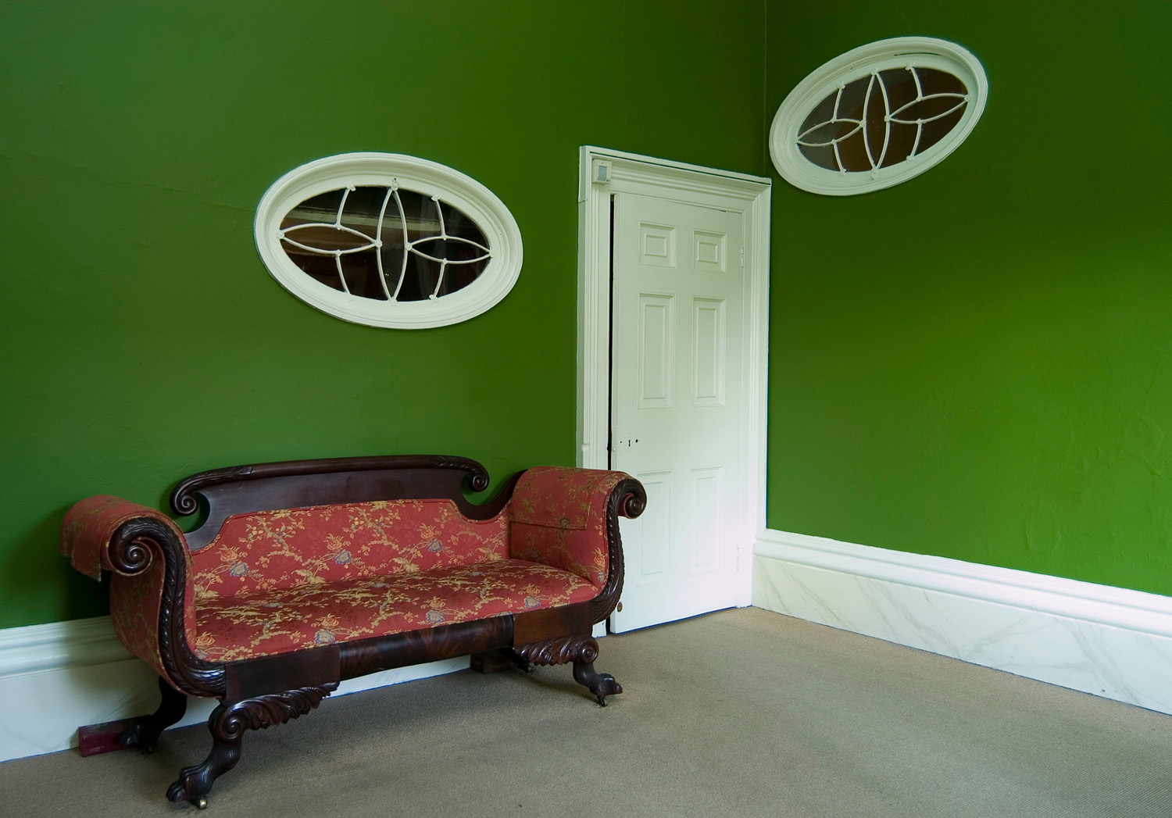
Rear entrance, Richards-Owens-Thomas House, 1817, 124 Abercorn St.,
SavannahGeorgia. William Jay, arch. Photo by Jeff Klee. 2006.
Notes:
He, like many others, has argued that people need things: shelter, tools, sacred spaces, pathways, beauty, and many others. We make these things systematically and intentionally based on our cultural experiences.

Slide 12
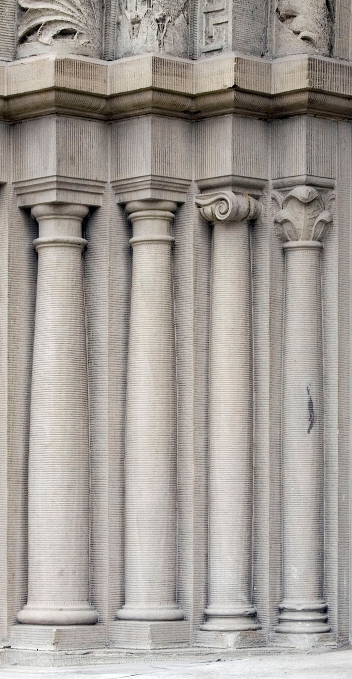
“Culture is unseen and immaterial, consisting of the ideas, values, and beliefs of a particular social group or society; but it is everywhere within us, shaping our behavior, helping us choose the right things to say, providing results for social interaction, and giving us mental blueprints for making the things we need, from bread pans to buildings.”
– Carter and Cromley, 2005
Detail, Masonic Temple, 1902. Butte, Montana. Photo by Susan Kern 2009.
Notes:
Culture, of course, is a complicated idea. But as Carter and Cromley define it:
“Culture is unseen and immaterial, consisting of the ideas, values, and beliefs of a particular social group or society; but it is everywhere within us, shaping our behavior, helping us choose the right things to say, providing results for social interaction, and giving us mental blueprints for making the things we need, from bread pans to buildings.”
So the everyday things that we see all around us are the results of those “mental blueprints.” They indicate and also help shape our cultural identities.
Vernacular Architecture studies, then, is a subset of Material Culture that focuses on buildings and groups of buildings.

Slide 13
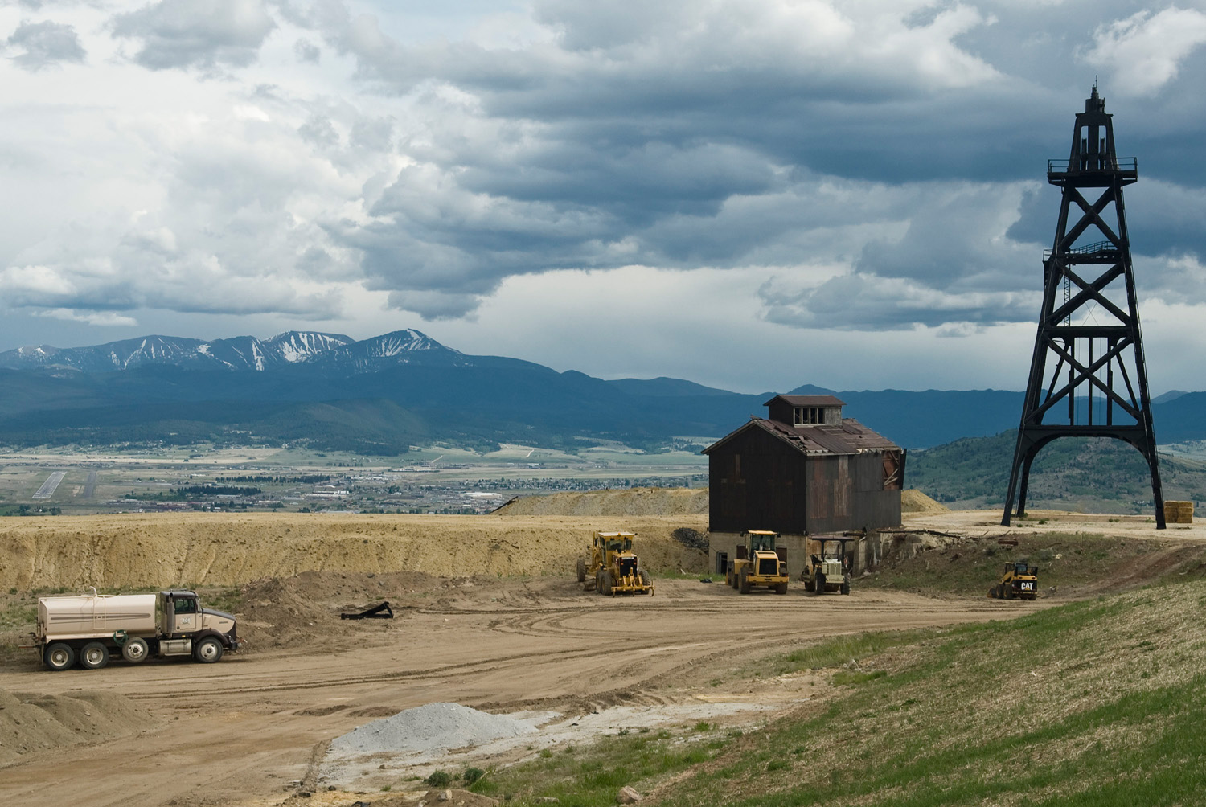
Berkeley Pit, Butte, Montana. Photo by Jeff Klee.
2009.
Notes:
We could also say that Vernacular Architecture studies is a subset of Cultural Landscape studies. Scholars with this focus ask similar “object-driven” questions about human behavior both past and present, but their objects of study tend to be of a much larger scale.
Often vernacular buildings develop important interpretive meanings when considered in the wider contexts of their surroundings. This can include considering a building’s interior in relation to what goes on outside. It can mean thinking about how a building’s use or associations change over time as the neighborhood, city, or region change around it. It can also mean reading a landscape in terms of larger systems of production or extraction, as in this mining landscape outside of Butte, Montana.
Other fields that often derive their questions from the study of artifacts, buildings, and landscapes include art history, archaeology, anthropology, folklore studies, historic preservation, architectural history, history, geography, and others.

Slide 14
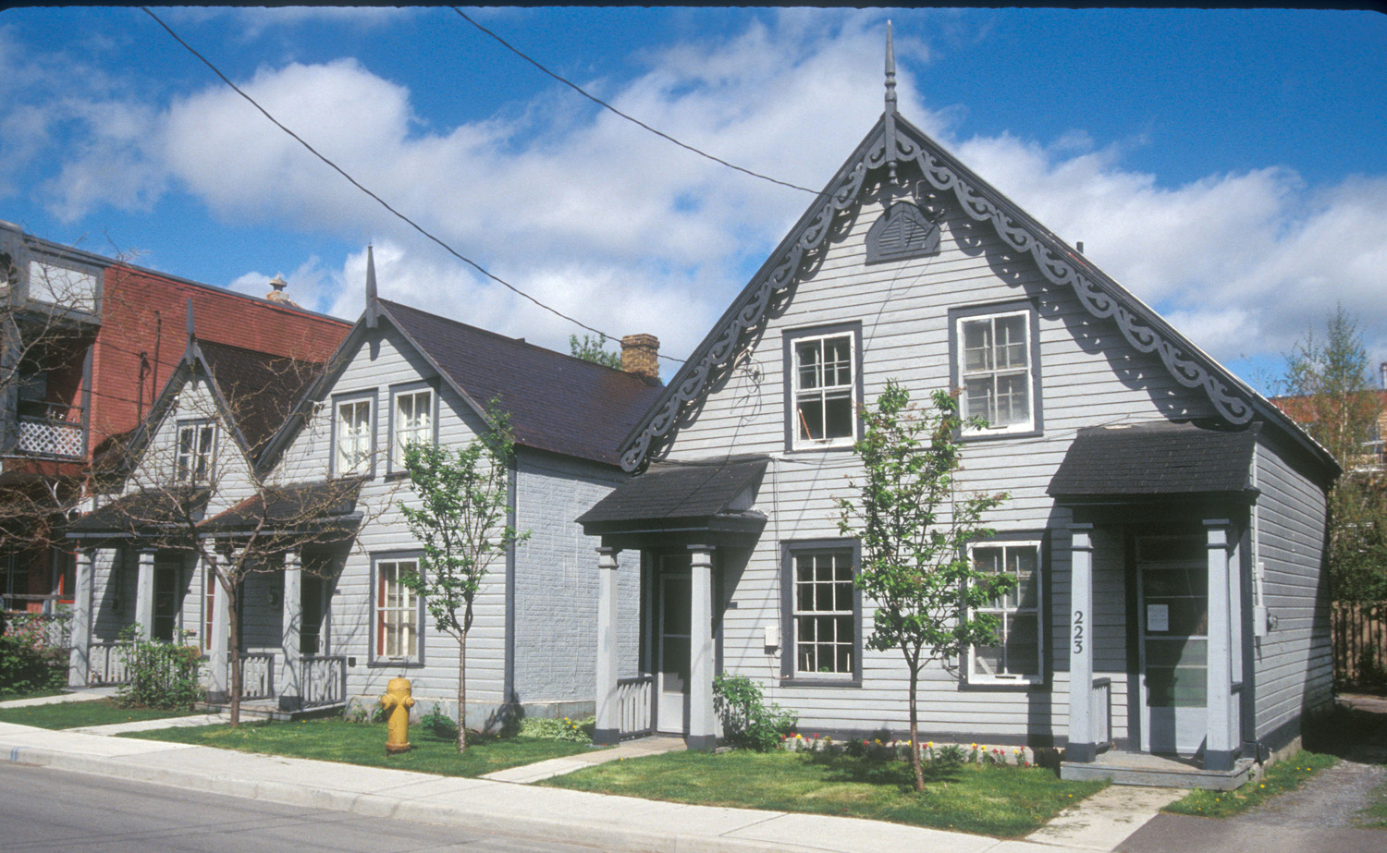
217–233 St. Andrew’s St, Ottowa, Ontario, Canada. Photo by Carl R. Lounsbury1995.
Notes:
How do we study Vernacular Architecture? And why?
We might all agree that a common house is a historic document of peoples’ lives and particular moments in time.
-- but we can’t read a house like a census record or a diary
-- we need more training
-- without more training we might only be able to say, “an important person lived here,” or “this house probably has memories for some people.”
With more training, we can learn to say to more.

Slide 15
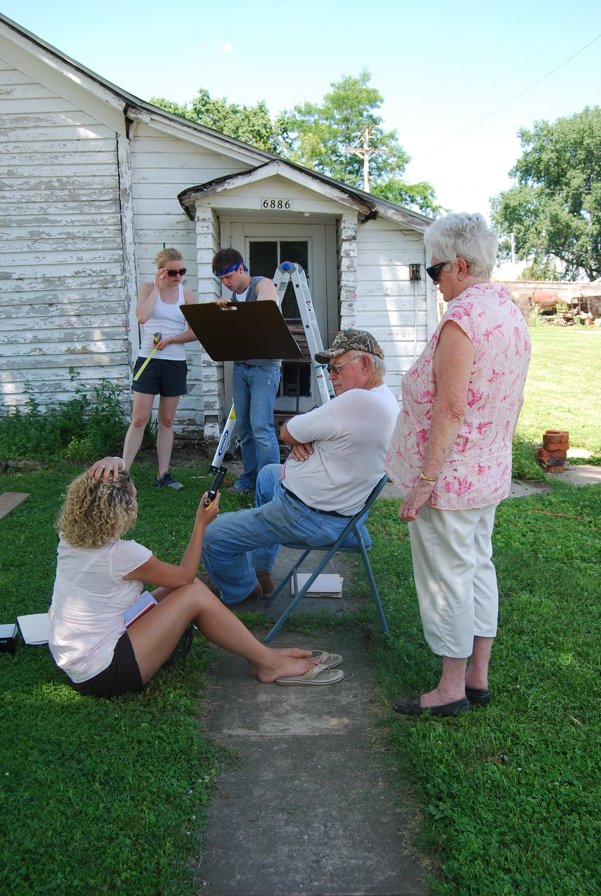
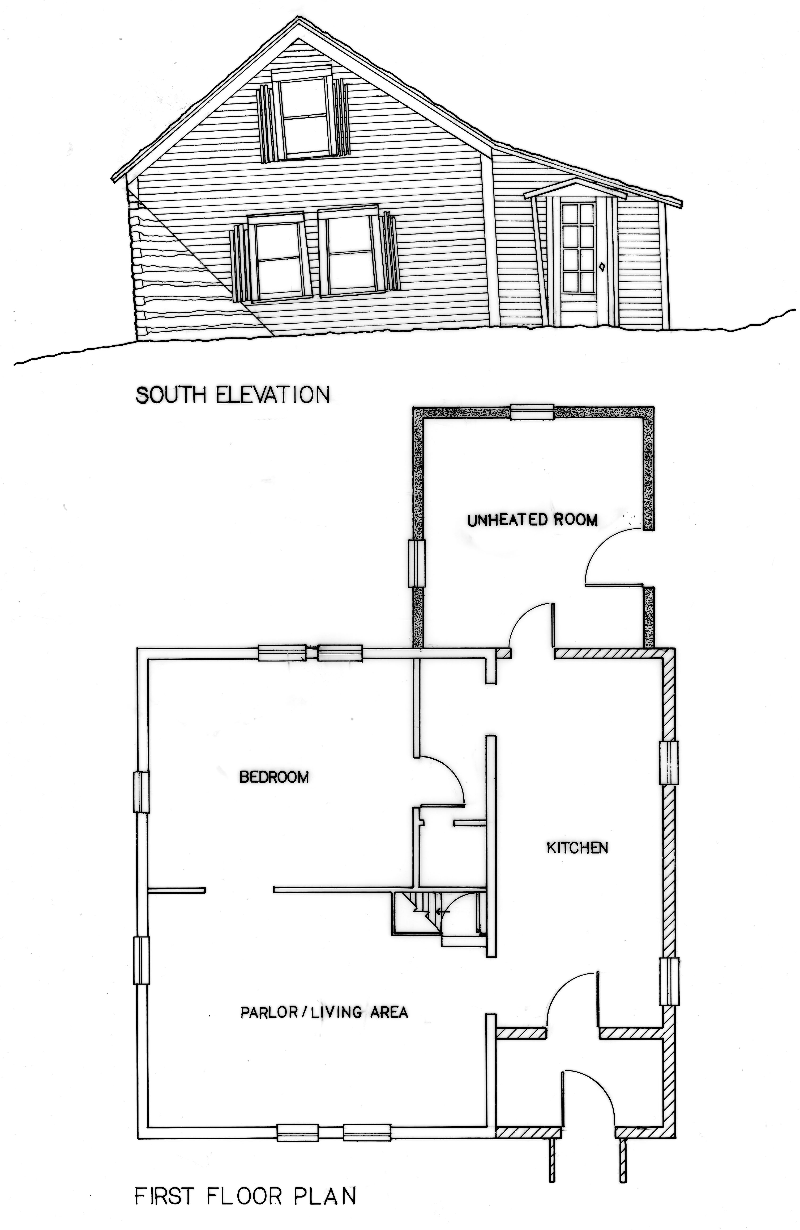
Harker-Enge-bretson House, 1830s. Wiota, WisconsinDrawing by Travis Olson based on fieldwork in 2009.
UW–Wisconsin Summer Field-school. Photo by Dee Finnegan. 2009.
Notes:
So we go in to the field to investigate buildings and landscapes. We don’t just look at them but we also:
-- document them – exteriors as well as interiors and floor plans
-- photograph what we can, but also…
-- measure them, and make field note drawings
-- redraw them, in ink or with Computer Aided Drafting software
Then we also find other types of evidence related to the building or landscape we are studying.
-- This can include recording oral histories, as is being done in this photograph…

Slide 16
U.S. Federal Census, 1860. Mineral Point, Iowa County, Wisconsin
Notes:
We also look for documentary evidence that can help pinpoint names of people who owned or were otherwise associated with the property, and the relationships between buildings and their landscapes.
This often includes items related to property ownership and residency like:
-- deed records and property sales
-- federal and state census records
-- local directories
-- newspaper advertisements and announcements

Slide 17
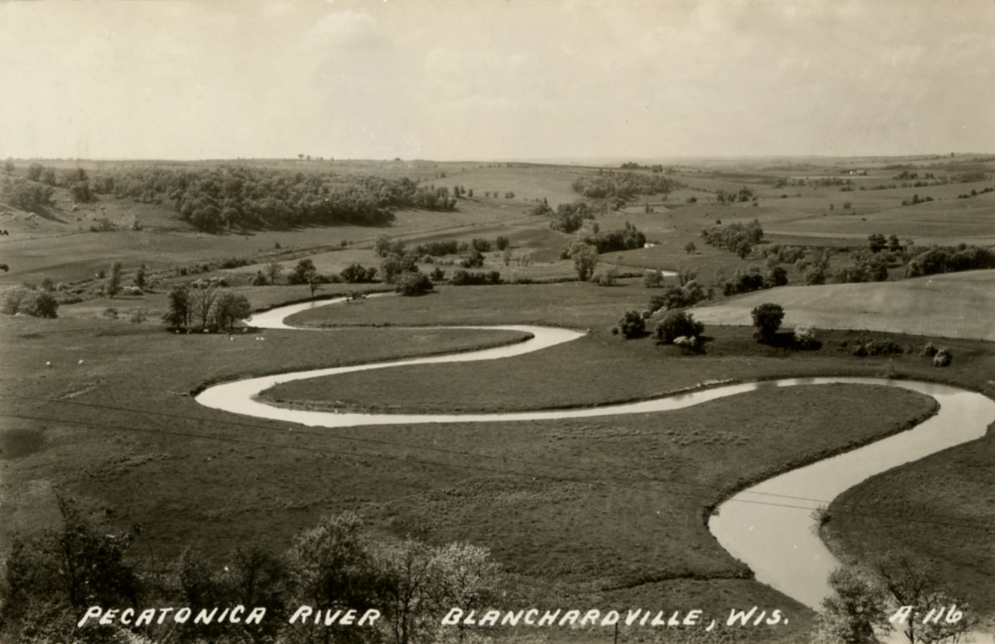
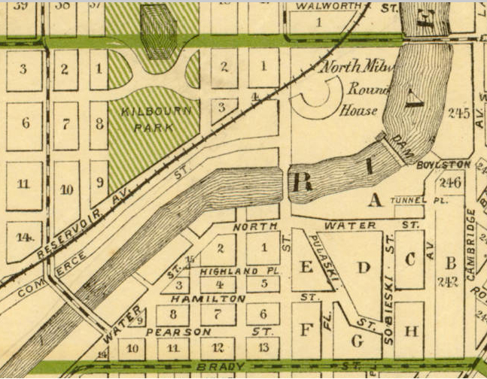
Detail from
A.G. Wright, “Wright’s Map of Milwau-kee,”
(Milwau-kee: Milw-aukee Lith. & Engr. Co., 1888.) American Geo-graphical Society Library Digital Map Coll., Univ. of Wisc.–Milwaukee
Early 20thc view of the Pecaton-ica River, Blanch-ardsville, WisconsinCourtesy Post Card Collection of Arnold R. Alanen.
Notes:
Also important are maps and historic photographs.
Both can provide significant clues about how a building or landscape looked at certain points in time, and also situate amidst everything else around them.

Slide 18
Diagram of Wiota, Wisconsin house types. Drawing by Thomas Carter and James Gosney, 2011.
Notes:
With multiple types of evidence gathered, we then analyze it, generate questions, and begin to answer them. We can begin to put together chronologies, and figure out how individual buildings or building types changed over time, as is shown here. These questions about time and form begin to uncover patterns that bring up more questions about context and function. What can these architectural alterations tell us about changing cultural attitudes or circumstances? How did these changes alter the lives of the people who used these buildings? Did similar changes happen elsewhere at the same time or does this community stand out? And why?
These questions help to uncover underlying tensions and complex meanings in a community, even from what can seem like a simple individual building or landscape.

Slide 19
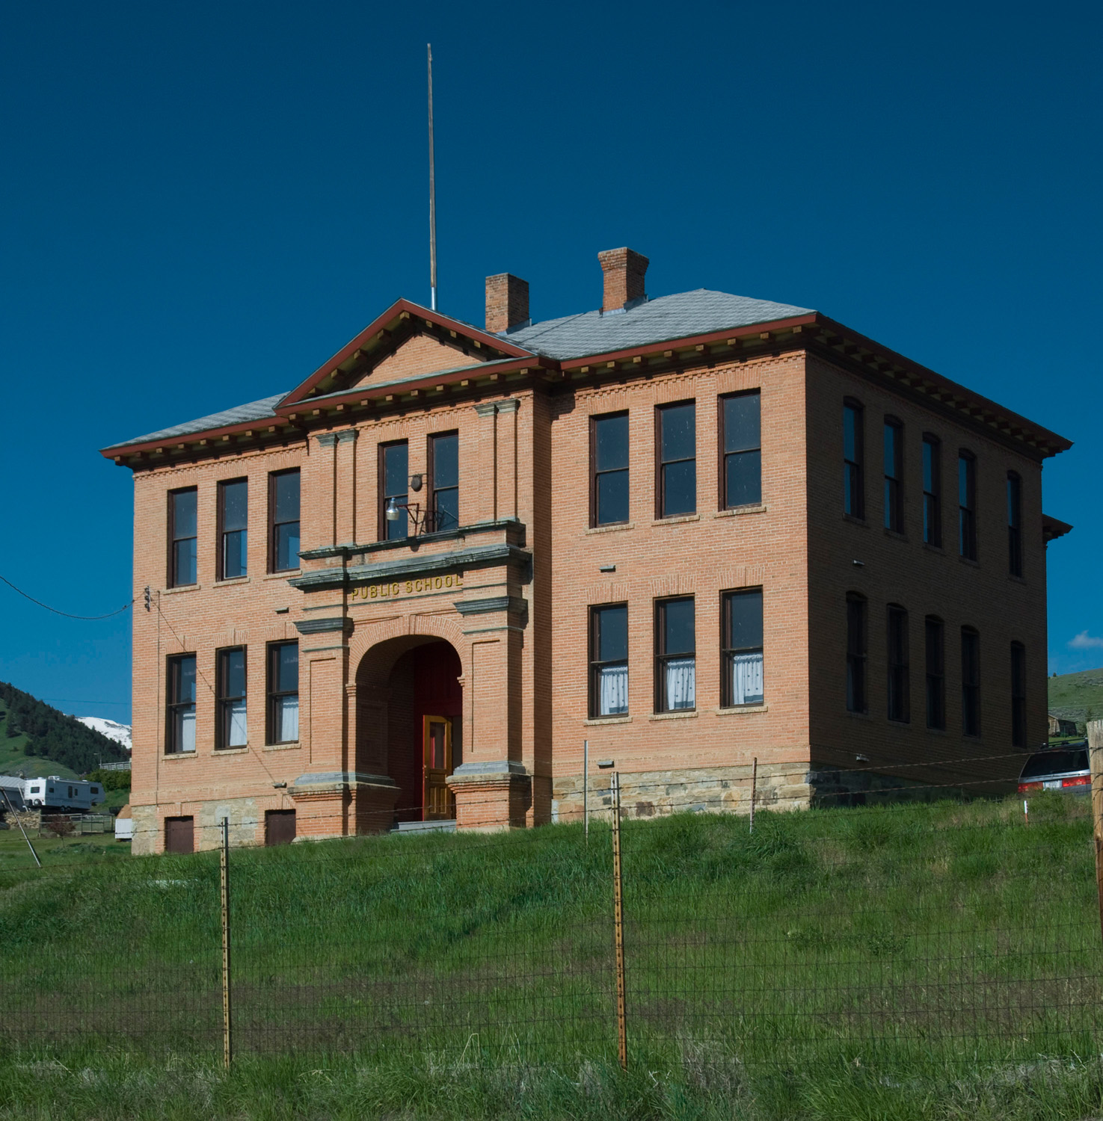
Public School, Pony, Montana. Photo by Jeff Klee.
2009.
Notes:
In the end, why is all this effort worth it? If we want to know more about human culture, then why not just use more traditional documents?
Studying vernacular architecture is not a panacea for professional historians, by any means. But it does contribute to our understanding of human culture in many ways that are not always available in other kinds of historical evidence.
Here are four of these major contributions:
Vernacular Architecture can bring us close to an ethnographic reading of people from the past. Historians can’t be ethnographers of their subjects since people from the past are generally dead. But having immediate contact with the buildings and spaces they built gives us a window into their worlds. Also, the actions recorded in their buildings do not have the same biases as diaries, personal letters, and published histories. People often ”say” things in their buildings and landscapes that they would never have written down explicitly.

Slide 20
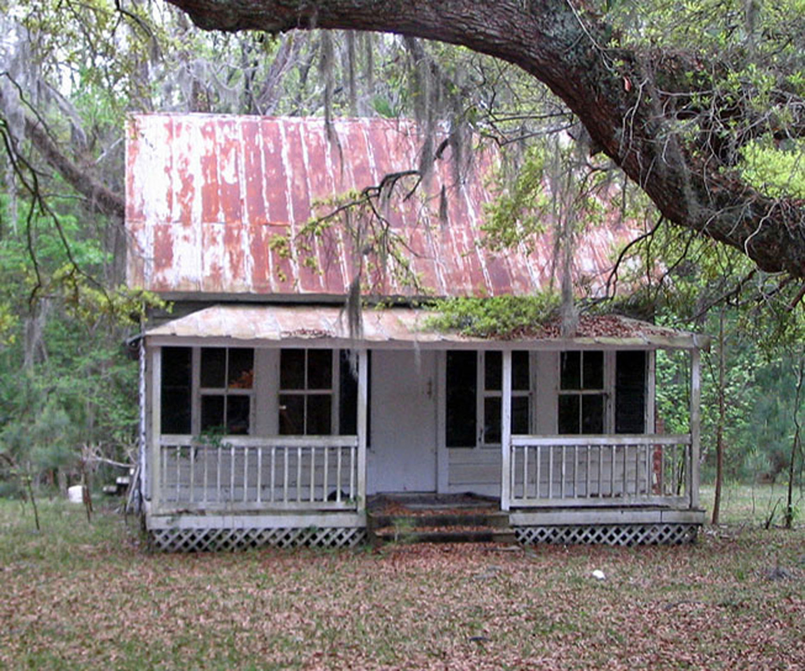
Under-taker’s Cottage, c. 1740. Beaufort Cty, South Carolina. Photo by Kevin Enns-Remple. 2007.
Notes:
2) We can learn about people who left no other kinds of records: for instance, the illiterate, and those who rarely show up in “official” histories like women, the enslaved, servants, children, minorities, the nomadic, and many others.

Slide 21
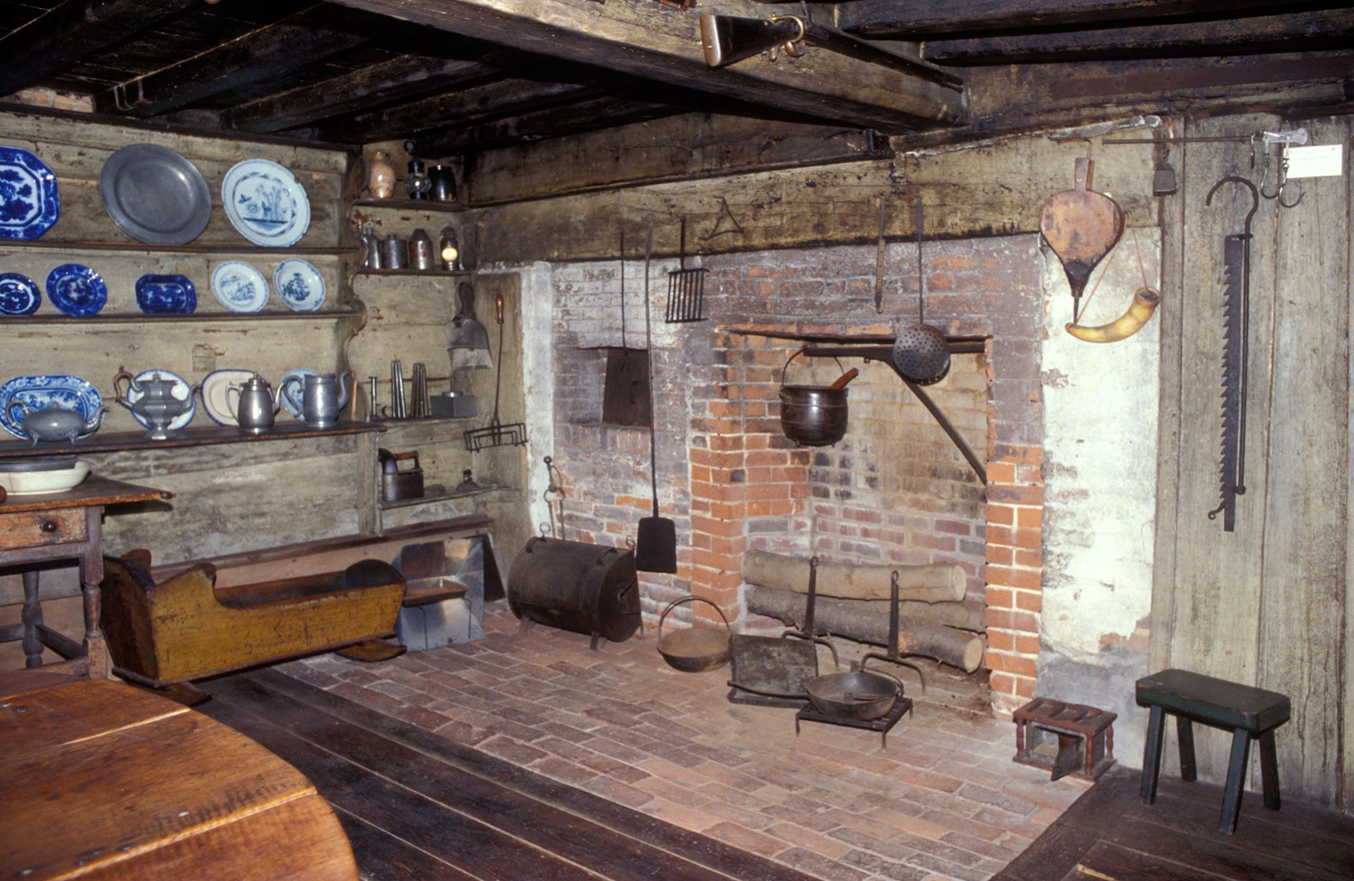
Kitchen, Fairbanks House, 1636, Dedham, Massa-chusetts. Photo by Willie Graham, 2000.
Notes:
3) We can uncover behaviors that were not recorded in other kinds of records, either because they were too mundane or they were forbidden or taboo. Diaries rarely record daily routines like cooking, cleaning, or walking to work, which all seemed to obvious to write down. But these types of actions are often lost to historians except in the physical spaces and structures where they occurred.
Also, most everyone had skeletons in the closet that they tried to erase from official records. Sometimes, those controversies, tragedies, mistakes, or injustices can be detected in the architectural evidence. Or more general taboos, like class differences, were rarely discussed outright but are often very obvious in the landscape.

Slide 22
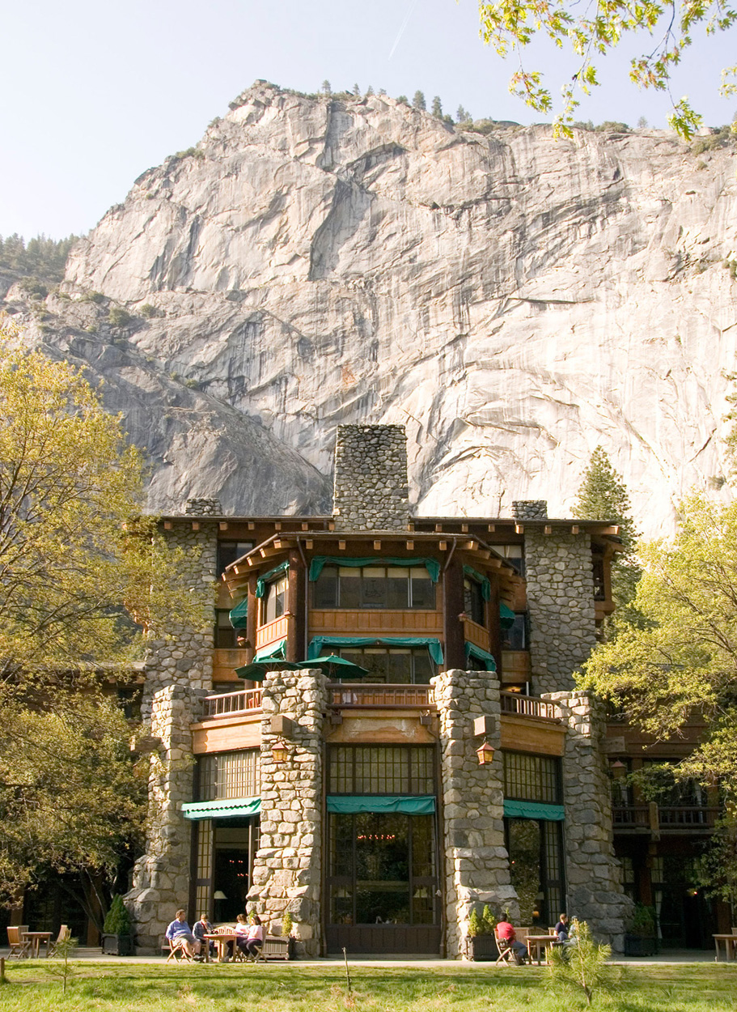
Ahwahnee Hotel, 1927, Gilbert Under-wood, architect, Yosemite National Park, Mariposa Cty, California. Photo by Carl R. Lounsbury2008.
Notes:
Lastly,
4) we get a fuller understanding of how people bring artfulness into their lives. Reading about what people think of as beautiful is not the same as looking at it.
The inspiration that architect Gilbert Underwood found in the grand mountains of Yosemite Valley in 1927, for instance, can be captured in this photograph more immediately than in other types of sources. Likewise, the care that was put into the log building that we saw earlier expressed a care for craftsmanship and knowledge of materials that probably was rarely written down.
We have to remember, however, that the architectural record is also skewed to some degree. As in the written record, the landscapes of the wealthy and powerful tend to survive more often than the landscapes of the disenfranchised. Likewise, metals and brick last longer than wood and adobe.

Slide 23
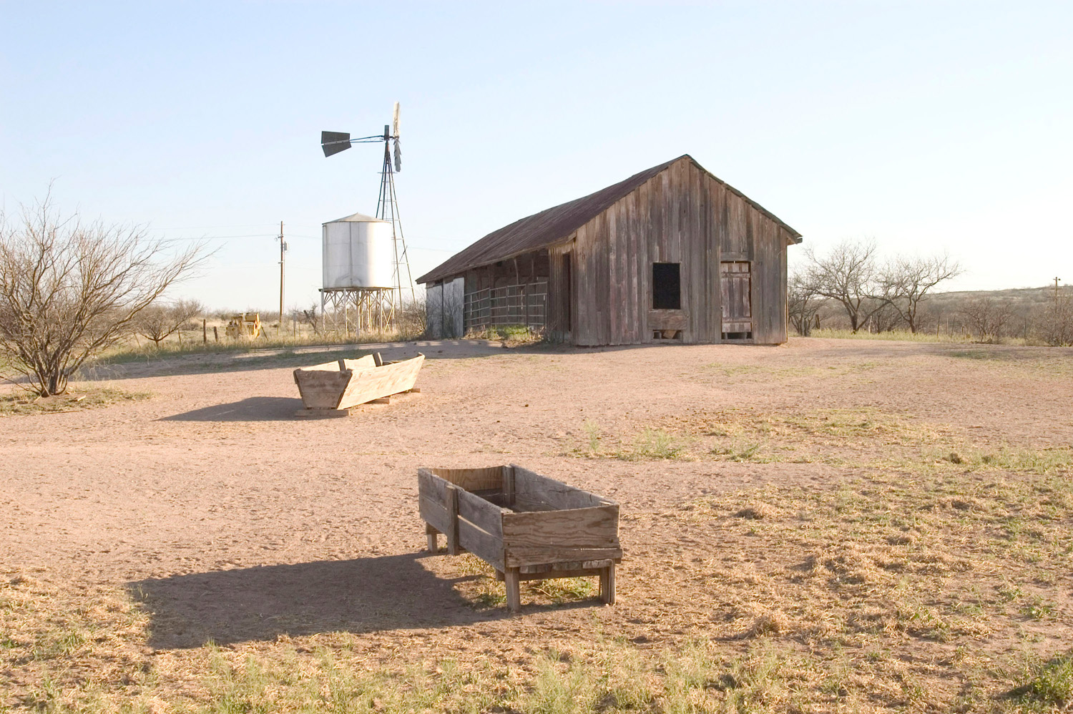
Empire Ranch. Pima Cty, Arizona. Photo by Carl R. Lounsbury2005.
Notes:
In the end, however, vernacular architecture can help us understand why we as humans have done what we have done, and who we are today.

